Slide 1

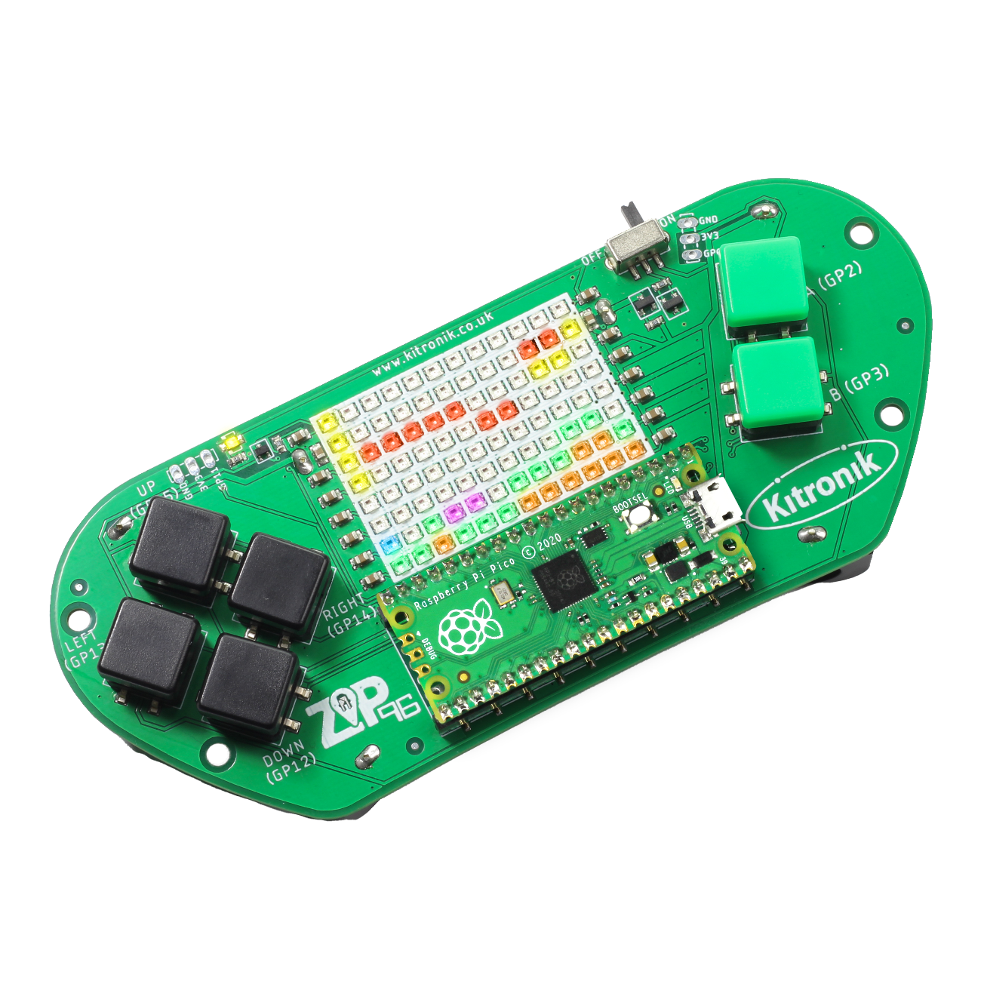
creating the a-mazing game
Computer Science

Slide 2

Aims & objectives
Computer Science
By the end of this lesson you will have:
Defined the ‘Enemy’ class.
Created the first enemy object and enabled it to move randomly in the maze.
Added functionality to make sure the enemy object interacts correctly with the maze walls.

Slide 3
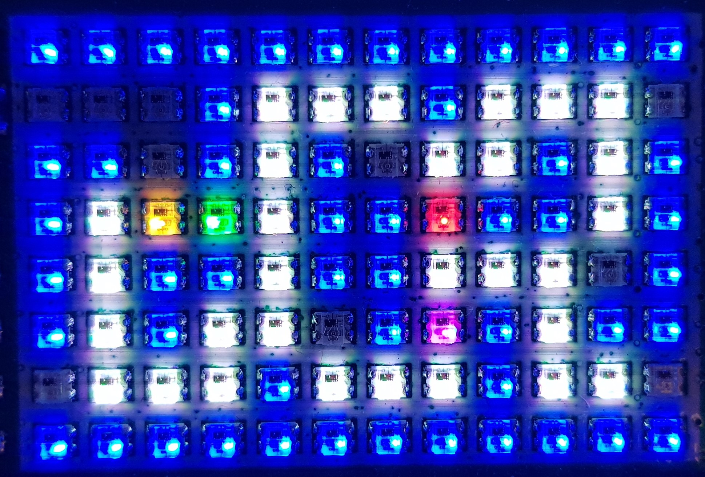
What is our a-mazing game?
Computer Science
A maze-based game where the player runs through a maze collecting gems – collect all the gems to win.
Three different enemies move around the maze as well, trying to stop the player from collecting gems.
One enemy moves randomly, one simply tries to move towards the player, the final one is smart and finds the best path through the maze to the player.
If an enemy catches the player, they lose a life. Once all three lives are lost… game over!

Slide 4
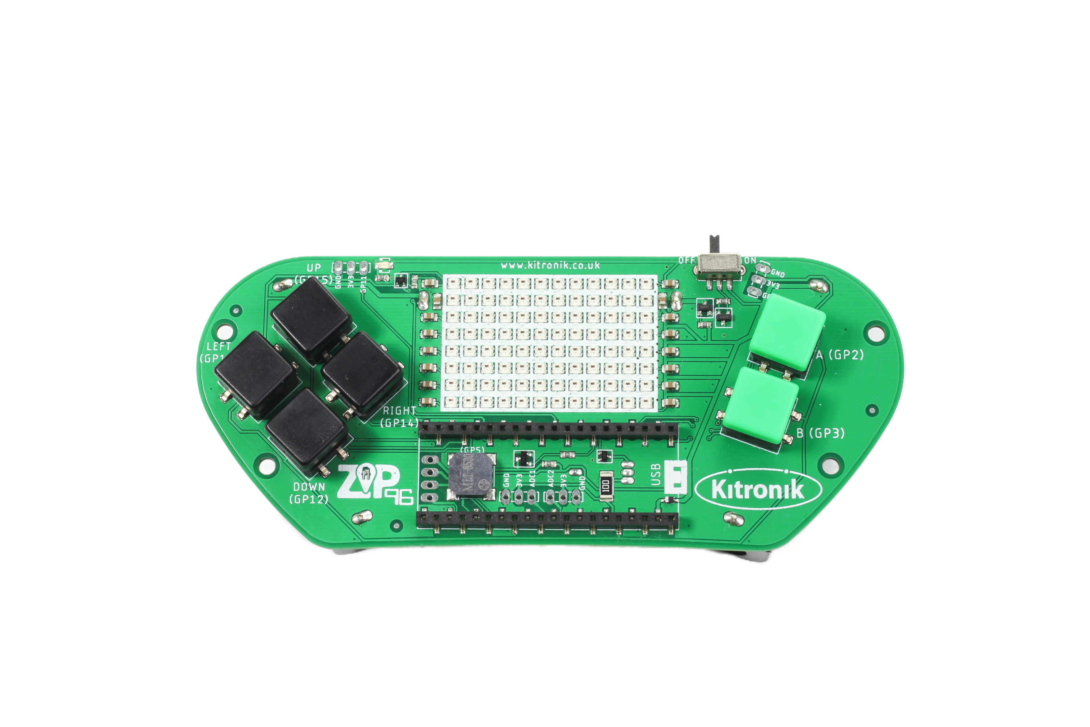
Thonny setup
Computer Science
Connect Pico ZIP96 to computer using a USB cable and open Thonny.

Slide 5
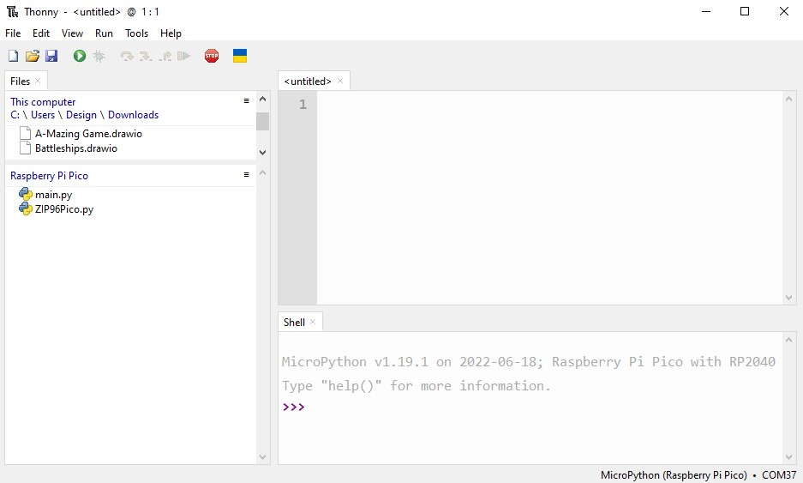
Thonny setup
Computer Science
Check the Pico device appears in the bottom right corner of Thonny.
Try pressing STOP if it does not appear automatically.
Turn on the ‘Shell’ by going to ‘View > Shell’.

Slide 6
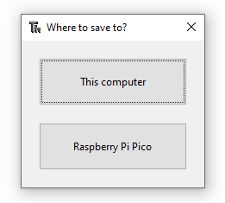
Thonny setup
Computer Science
Create a new file by clicking ‘File > New’.
Save it to the Pico by clicking ‘File > Save as’ and then select ‘Raspberry Pi Pico’.
Name the file ‘main.py’.

Slide 7
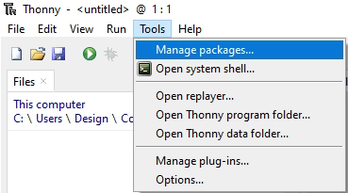
Thonny setup
Computer Science
Install the ‘ZIP96Pico’ library onto the Pico.
Click on ‘Tools > Manage Packages…’

Slide 8
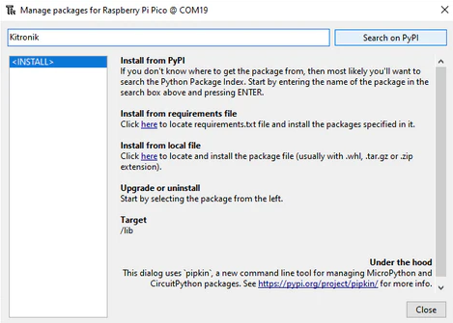
Thonny Setup
Computer Science
With the ‘Manage packages’ window open, search for ‘Kitronik’ and click the ‘Search on PyPI’ button.
Locate ‘KitronikPicoZIP96’ in the list of search results, then click the ‘Install’ button.
Confirm the install by clicking ‘Yes’ if prompted by Thonny.

Slide 9
Coding: random import
Computer Science
At the start of the program, add this import statement:
import _thread
from random import randint

Slide 10
Defining the enemy class
Computer Science
What information will the enemy class need to store?
The enemy will need to know:
its x and y position on the screen,
the colour used for the player LED,
the walls used in the maze,
the gems used in the maze,
the screen object to draw the enemy on the ZIP96,
the screenWidth and screenHeight to detect when the enemy moves off the screen.

Slide 11
Coding: enemy class
Computer Science
After the Gem class, define the Enemy class:
# Class to store our Enemy functionality
class Enemy():
# Enemy object constructor
def __init__(self, x, y, colour, walls, gems, screen, screenWidth, screenHeight):
self.x = x
self.y = y
self.colour = colour
self.walls = walls
self.gems = gems
self.screen = screen
self.screenWidth = screenWidth
self.screenHeight = screenHeight
# Draw the starting position
self.draw()
# Draw the current position on the screen
def draw(self):
self.screen.setLEDMatrix(self.x, self.y, self.colour)

Slide 12

Maze interaction
Computer Science
What needs to be different about how the enemy object interacts with the maze, when compared with how the player interacts?

Slide 13
Coding: enemy & gem collisions
Computer Science
After the draw() function in the Enemy class:
# Draw a blank space in the current position on the screen
def drawEmpty(self):
self.screen.setLEDMatrix(self.x, self.y, self.screen.BLACK)
# Check each Gem in our list
for gem in self.gems:
# If the Enemy is colliding with a Gem
if gem.collision(self.x, self.y):
# Redraw the Gem. Resets the LED to white if a gem is there
gem.draw()
break

Slide 14
Coding: enemy & gem collisions
Computer Science
After the draw() function in the Enemy class:
# Update the current position randomly
def moveRandom(self):
# Reset the current position on the screen
self.drawEmpty()
# Set the move parameters randomly
x = 0
y = 0
random = randint(0, 3)
if random == 0: x = 1
elif random == 1: x = -1
elif random == 2: y = 1
else: y = -1
# Change the current position
# by the x and y parameters
self.x += x
self.y += y
# Update the new position on the screen
self.draw()

Slide 15
Coding: create list for enemy objects
Computer Science
After the player object:
At the end of the game loop, before the show() call:
# List to store our Enemy objects
enemies = [Enemy(6, 2, gamer.Screen.RED, walls, gems, screen, screenWidth, screenHeight)]
# Check each Enemy in our list
for i in range(len(enemies)):
# First Enemy moves randomly
if i == 0: enemies[i].moveRandom()
# Show the updates on the screen
screen.show()
Run the program to test the random enemy movement

Slide 16
Coding: create list for enemy objects
Computer Science
While testing, try to figure out what functionality is missing from the moveRandom() function.

Slide 17
Coding: Boundaries & collisions
Computer Science
After the draw() function in the Enemy class:
# Check the new x position is valid (not off the edge of the screen)
if (self.x < 0): self.x = self.screenWidth - 1
if (self.x >= self.screenWidth): self.x = 0
# Check the new y position is valid (not off the edge of the screen)
if (self.y < 0): self.y = self.screenHeight - 1
if (self.y >= self.screenHeight): self.y = 0
# Check each Wall in our list
for wall in self.walls:
# If the Enemy is colliding with a Wall
if wall.collision(self.x, self.y):
# Undo the new position using the x and y parameters
self.x -= x
self.y -= y
# Cannot collide with more than one Wall so leave loop
break

Slide 18
Test screen boundaries & wall collisions
Computer Science
Run the program to test the random enemy movement – check it does not disappear from the screen or move through walls

Slide 19
conclusion
Computer Science
In this lesson you have:
Created the ‘Enemy’ class, its constructor and methods.
Used a for loop, if statement and Boolean logic to check for interaction between Enemy and Wall objects.
Used the random library to include random behaviours in the maze game.

